Slide 1

Controlling Player Avatars in Game Worlds using Multi-Modal Input Systems
Final Year Project: Progress Presentation
Notes:
My project is about building a system that will allow for the combined acquisition and analysis of real-time data from EEG, EMG and eye-tracking devices.
Using said system, behaviours and interactions within a games world will be explored, with the creation of two example demo’s being created along side, demonstrating the usage though the control of an avatar skeletal rig and the scaling of game difficulty.

Slide 2
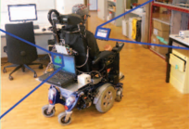
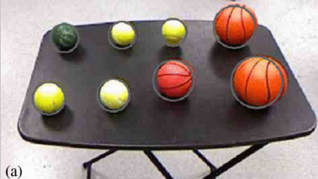
Literature Review - Key Studies:
Brain-controlled wheelchairs: a robotic architecture [ 6 ]
The authors of the paper used a 16 electrode EEG headset to capture motor imagery data, feeding these signals, along side the results of a computer vision network, into a multi-modal input and analysis system they where able to allow for the real time control of a wheel chair for motor impaired person. Allowing for the disregarding of ERP’s, and the constant stopping to verify user inputs, the system used path finding, and obstacle avoidance to infer meaning from where the user wanted to go rather then the typical left and right responses seen in motor imagery work.
Demonstration of a semi-autonomous hybrid brain--machine interface using human intracranial EEG, eye tracking, and computer vision to control a robotic upper limb prosthetic [ 14 ]
Using computer vision, eye tracking and motor imagery based EEG the authors of the study where able to get a prosthetic arm to pickup objects when the user tried to do so. This showed reasonably accuracy with both when the arm activated and for what object it reached. This was made more accurate by removing the direct control from the user, and leaving much of the more difficult manoeuvring of the arm to IK models.
Notes:
#MAY ADD 3RD EXAMPLE
Multi Modal system using EEG and EMG for serous or entertainment based game controls are basically non existent (or at least I couldn’t find anything), that however isn’t to say that inspiration cannot be drawn from the multi-modal systems used in the real world.
These two examples demonstrate the effective usage of combining EEG sensor data with other analysis and input modalities to allow for a system to function much better then what it otherwise would be doing if it was left on its own.

Slide 3
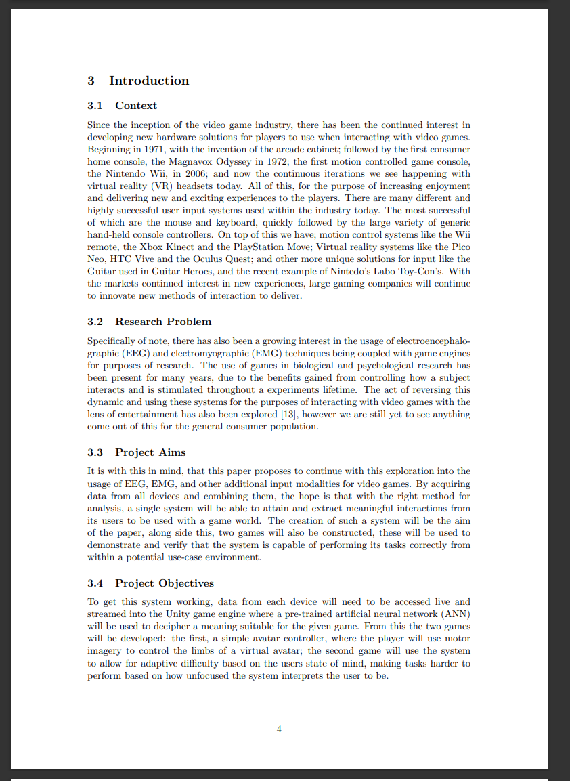
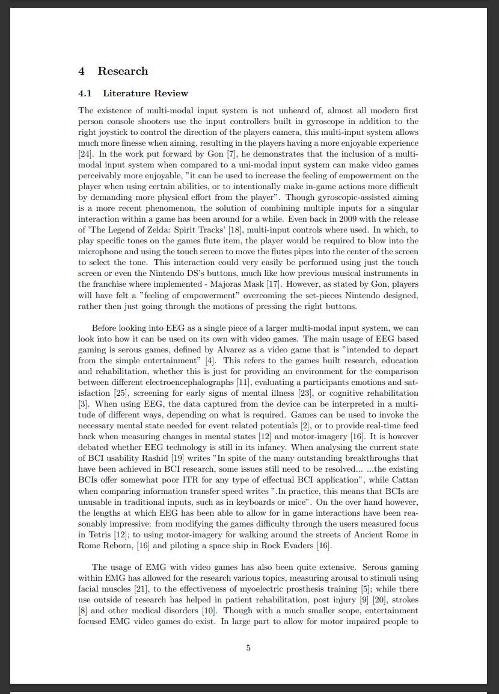
The Dissertation Progress:
Introduction
Context
Research Problem
Project Aims
Project Objectives
Lit Review
Current examples of multi-modal input systems
Uni-modal EEG systems in gaming
Uni-modal EMG systems in gaming
EEG / EMG based multi modal input systems
Reference Count: 23 papers
Roughly 2000 words
Notes:
The contents page, reference page and the first 2 chapters of the dissertation are complete (though only in draft form)
These two section cover just under 2000 words. Each section has been split into the format show above.

Slide 4
The Prototype Progress
Processing
Barracuda
Tensorflow -> ONNX -> Barracuda
Tensorflow
XOR
Offline processing
Open Vibe
Data Capture
LSL
EEG
What I have done Prototype

Slide 5
Faces
EEG reading?
Project I have worked on

Slide 6
60 Second Showcase
YouTube Link

Slide 7
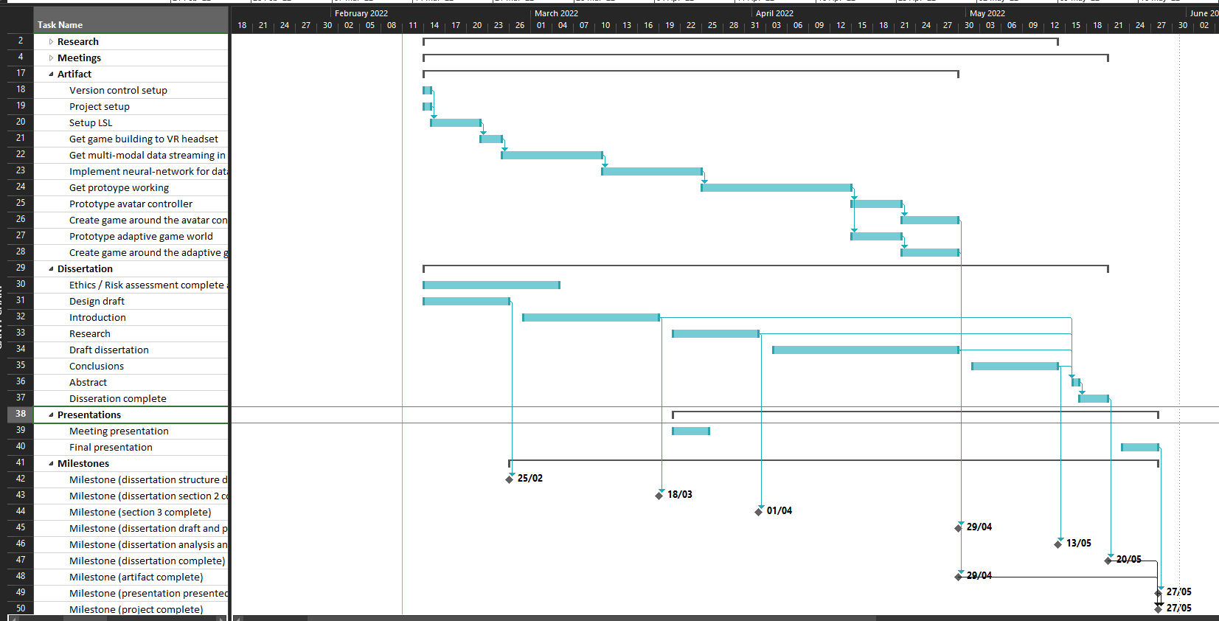
Where I Am:
Today
Project Plan:
Artifact
Setup Version Control
Setup Unity Project
Get LSL working across devices
Implement Neural Network for data analysis
Setup Tensorflow online analysis through Unity
Design and train a network using offline EEG / EMG data
Dissertation
Ethics / Risk assessment hand in.
Dissertation Draft
Introduction – (draft)
Literature Review – (draft)
Notes:
So far I am reasonably on track with what I set out to do at the start of the project, having only one part of the project – being the implementation of the offline ANN classifier for motor imagery not working – however this I am already in the process of working on.

Slide 8
Future Plans:
Next few weeks:
Artifact
Get a working offline analysis model for EEG motor-imagery classification.
Then get this working in real time with Unity, though this will still be feeding in offline data.
Do the same for the Emotibit, EMG data.
Dissertation
Polish up drafted sections and continue the literature review.
Start methodolgy
Later:
Artifact
Modify the neural networks to support the analysis of all modalities instead of just them separately.
Train this to accomplish specific tasks, such as moving avatar skeleton bones, or influencing the difficulty of a simple game.
Get two demonstration games built to demo the system.
Dissertation
Finish methodology
Notes:
Over the next few weeks I plan on starting the implementation of the offline EEG classifier, once this is complete I may be able to then look into combining other data along side it to see if the multi-modal input system can be created. (potentially look into eye tracking and check how much stress from eye movement for difficulty paradigm)
After which I will also need to finish up the first 2 chapters to a state I am reasonably happy with (not to say I wont change them in the future but they do need work)
Once all of this is done, there is still larger aspects of the project that will need to be looked into, this will be the creation of the system fully, the creation of the two games and finally writing the rest of the report.

Slide 9
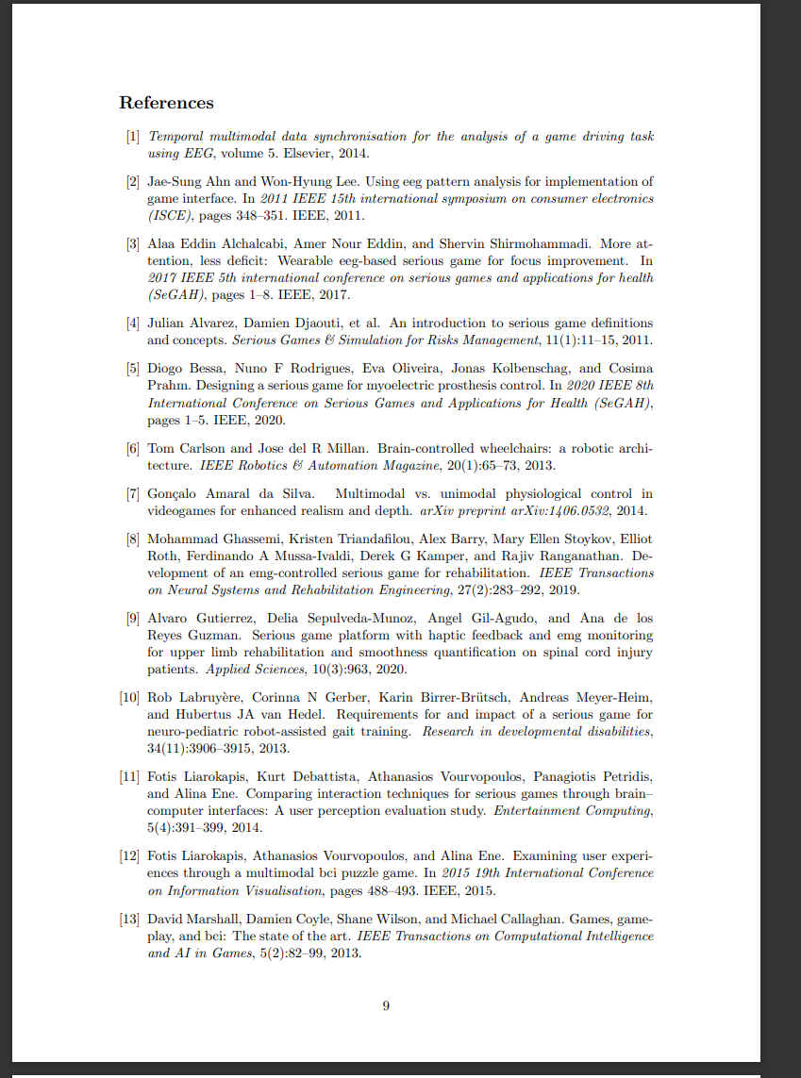
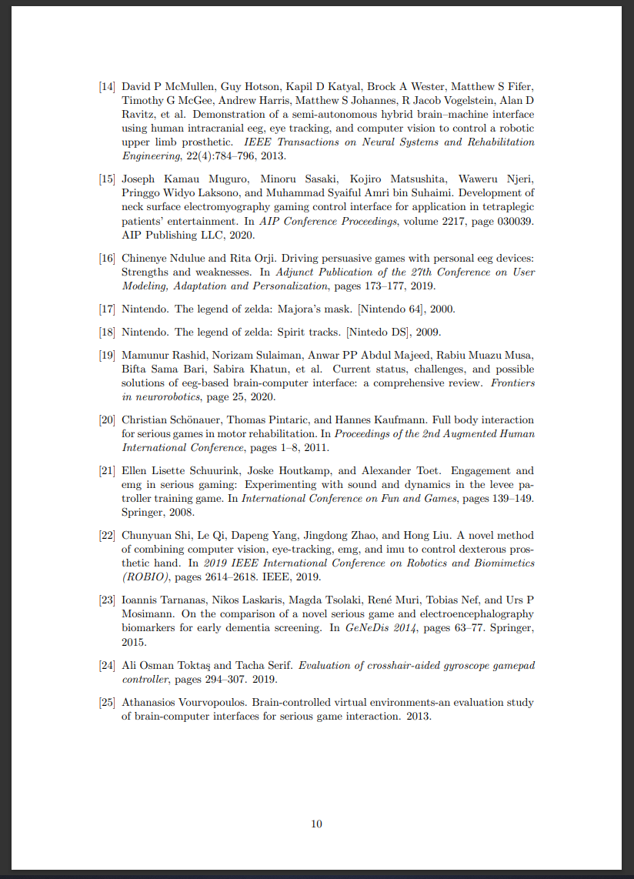
Reference:
Used in Presentation
(Carlson, 2013)
(McMullen, 2013)

